Slide 1

无人机航拍场景下的语义三维重建
陈煜1701213988@pku.edu.cn
王尧 wangyao@pku.edu.cn
王旭普 wangyao@pku.edu.cn

Slide 2
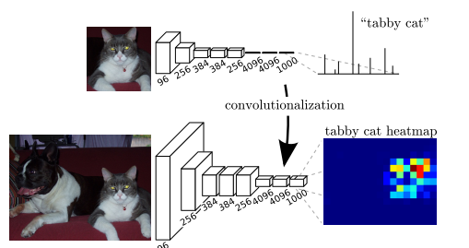
Semantic segmentation
FCN: Transforming fully connected layers into convolution layers

Slide 3
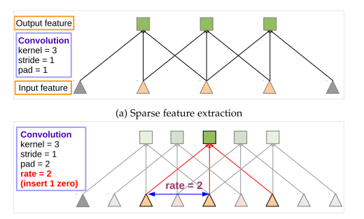
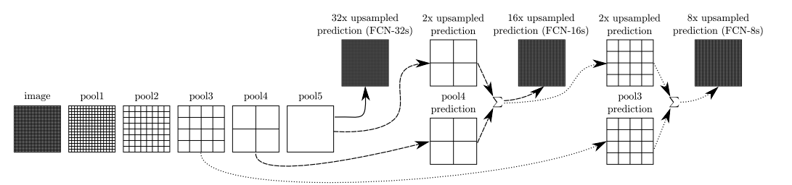
from FCN to Deeplab
问题 | deeplab解决方案
特征图（feature map）分辨率过低 | 膨胀卷积(Atrous convolution)
多尺度物体 | 膨胀金字塔池化(Atrous spatial pyramid pooling )
池化后不能准确反映位置 | 全链接条件随机场(Fully connected CRF)
Atrous(dilated) convolution

Slide 4
Dataset Construction
Data selection
Semantic labeling
Post process
Enrich the variety from different:
Drone height
Light(shadow)
Camera angle
Image content
The labeling pipeline is:
By photo shop
Semi-automatic
5 min per image
The main goals are:
To combine semantic masks into single ground truth label
To deal with multi-labeled/unlabeled pixel
Train_set | Validation _set
156 | 30

Slide 5
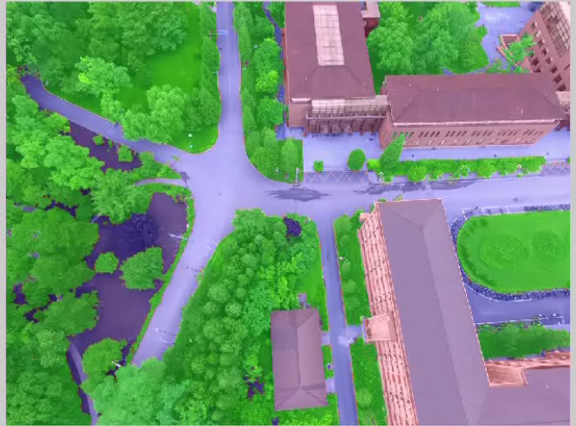
Dataset glimpse

Slide 6
Training
Hyper Parameters
Backbone network | Resnet-101
Crop size | 513*513
Init Learning rate | 1e-4
batch size | 12
Weight decay | exp 0.98
Max epoch | 10
Result
MIoU | 88.7
Mean accuracy | 94.1

Slide 7
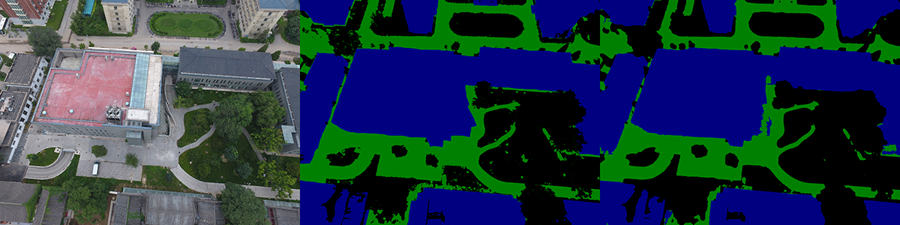
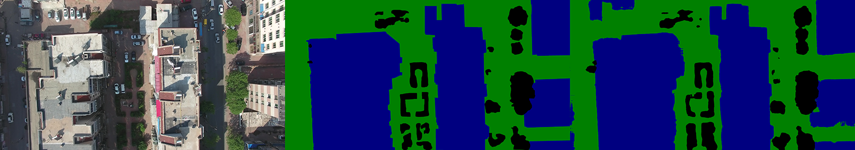
Result
campus
huludao

